Slide 1


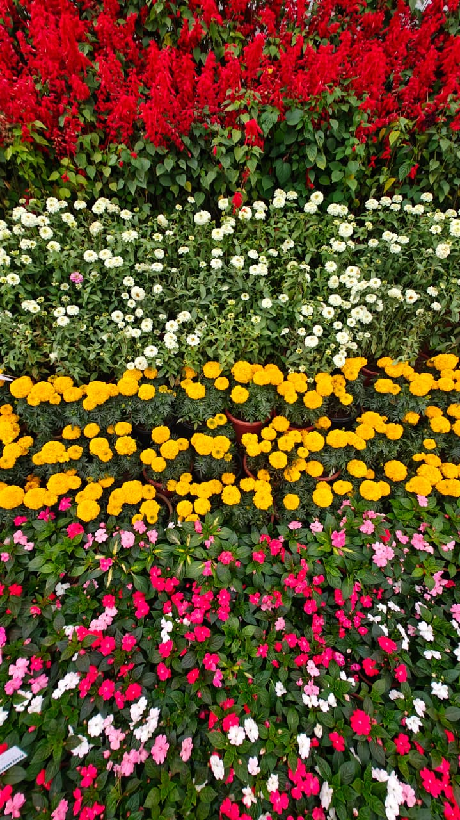
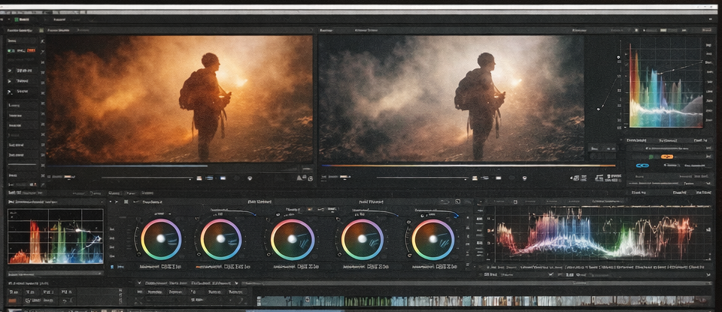


RV College of Engineering, Bengaluru – 560059.
Go, change the world
PHOTOGRAPHY & FILM MAKING (HS237LH)
Mentor:
Prof. Shanmukha Nagaraj
Aryan Lodha | Arnav Jain | Arush Jain | Veeral Jain
1RV24IM064 | 1RV24EC033 | 1RV24EC034 | 1RV24ME123
Introduction to Photography
Description of Software tools used
Visual media has become one of the most powerful tools for communication in the digital age. Photography and video are no longer limited to professionals with high-end equipment; they are now accessible to anyone with a smartphone and creative vision. This poster explores how fundamental photography principles, mobile-based techniques, and modern editing software combine to create impactful visual storytelling.
“Big stories begin with simple frames.” - Anonymous
DaVinci Resolve
A professional video editing and color grading software widely used in the film industry for advanced color correction, visual consistency, and cinematic output.
Adobe Premiere Pro
A non-linear video editing application used for professional video editing, sequencing, transitions, and post-production workflows.
Adobe Lightroom
A photo editing and color correction tool used for enhancing images, adjusting tones, and maintaining visual consistency across photographs.
Canva
A graphic design platform used for creating posters, layouts, titles, and visual presentations with a clean and structured design approach.
CapCut
A mobile-based video editing application used for quick edits, transitions, effects, and exporting content optimized for digital platforms.
VN Video Editor
A lightweight video editing tool offering precise trimming, transitions, and basic color adjustments, suitable for mobile video editing.
Fundamentals of Still Photography
Composition Techniques for Effective Visual Communication
Composition plays a critical role in shaping how a photograph is perceived. It involves the deliberate arrangement of visual elements to establish balance, focus, and meaning. Strong compositional choices help transform simple scenes into clear and engaging visual messages.
Concepts explored include:
Balanced framing using the Rule of Thirds
Visual direction through leading lines
Use of natural frames to enhance subject focus
Symmetry and patterns for structured aesthetics
Strategic subject placement for visual clarity
Course Learning Outcomes with few photographs and demonstration
This photograph demonstrates the use of the Rule of Thirds and natural framing to emphasize the main subject. A shallow depth of field helps isolate the flower from the background, while soft natural lighting enhances texture and visual clarity. The composition draws the viewer’s attention directly to the subject, creating a balanced and aesthetically pleasing image.
Innovative techniques of Mobile Photography
Optimizing Exposure and Focus in Smartphone Photography
Smartphone cameras are equipped with advanced imaging capabilities that allow precise control over exposure and focus. When used effectively, these features enable the creation of sharp, well-exposed images suitable for professional and academic use.
Practical techniques applied:
Manual adjustment of exposure and focus parameters
Focus locking for consistent image sharpness
Control of highlights and shadows for balanced lighting
Intelligent use of HDR for dynamic range enhancement
Improving image quality in low-light environments
Captured with ISO 200, 14 mm focal length, f/2.2 aperture, and a shutter speed of 1/50 s, this image highlights the effective use of color contrast, repetition, and pattern in still photography. The organized arrangement of flowers creates strong visual rhythm and balance across the frame. Clear separation of colors guides the viewer’s eye smoothly through the image, demonstrating how composition and color harmony enhance visual appeal and impact.
Video Editing Techniques
Conclusions
This project demonstrates that effective visual storytelling is achieved through a strong understanding of fundamentals rather than reliance on expensive equipment. By applying principles of composition, mastering mobile camera controls, and using professional video editing software, high-quality photographs and cinematic videos can be produced with accessible tools.
Overall, the project highlights how modern tools, when combined with strong foundational knowledge, enable impactful and professional visual communication.
References
Color Correction and Color Grading for Cinematic Output
Color correction and color grading are essential stages of video post-production that enhance visual quality and storytelling. These processes ensure consistency across clips while establishing mood, tone, and emotional depth. Proper color treatment helps maintain realism while giving the video a polished, cinematic appearance suitable for professional presentation.
Editing principles implemented:
Exposure and white balance normalization
Maintaining color continuity across scenes
Contrast and saturation refinement
Mood enhancement through color grading
Achieving a professional cinematic visual style
Course Material – Photography & Film Making (HS237LH)
Blackmagic Design. DaVinci Resolve Official Documentation
Adobe Systems. Lightroom and Premiere Pro Learning Resources
Canva Design School – Visual Communication Guidelines
Online tutorials and educational resources on photography and video editing
QR Code of the Demonstration Video
FILM MAKING STILL PHOTOGRAPHY

